Slide 1
A Scheme for Factoid Question Answering Over Knowledge Base
Happy BUZAABA, Toshiyuki AMAGASA
2019 - 02 - 25
KDE-LAB
UNIVERSITY OF TSUKUBA

Slide 2
Discussion with Sensei
Objective slide
Talk about growing of knowledge bases and Need to query data by non-technical people (sparql etc)
Types of question answering
Change the task description slide artistic
Change network structure
Add future work in conclusion

Slide 3
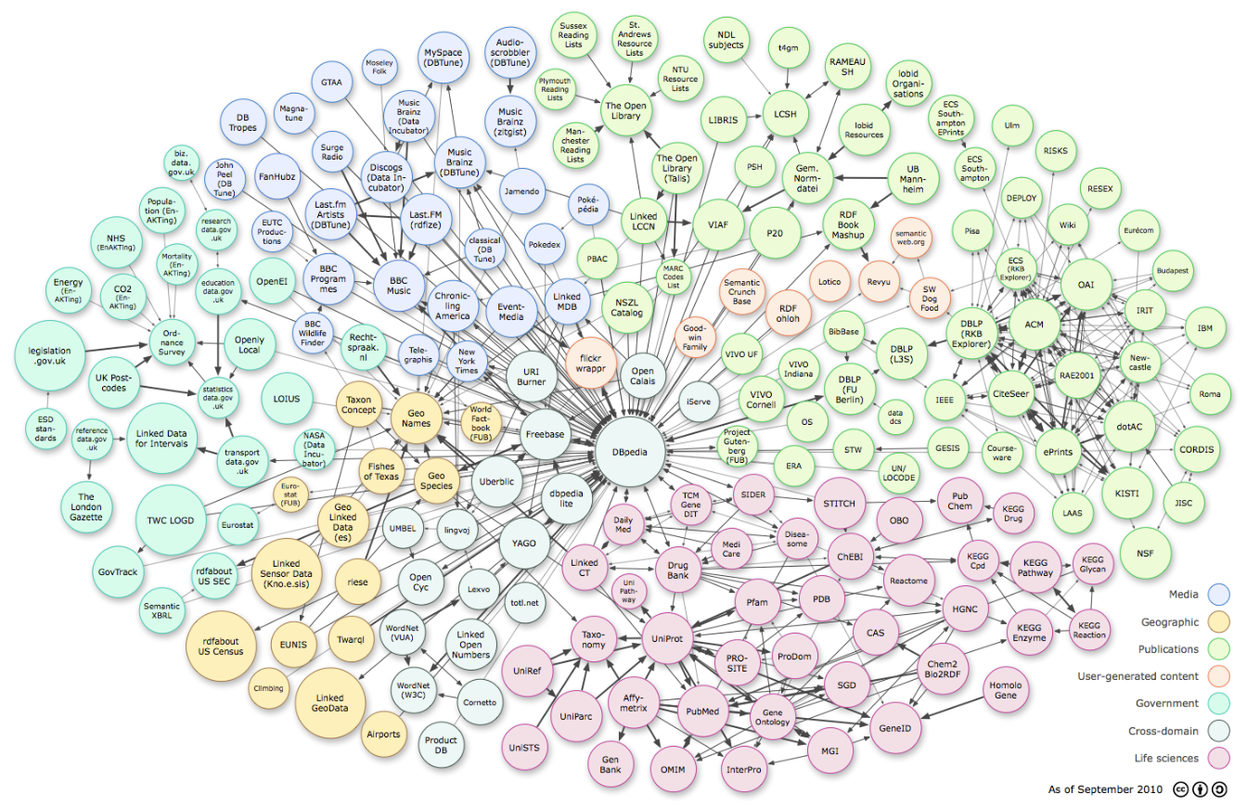
Knowledge Bases
A Scheme For Factoid Question Answering over Knowledge Base
February 25, 2019 3/29
Notes:
Lets start from the picture
This picture contains most of the Knowledge bases that have been widely used in both academic community and industry products
Colors represent the Domains
Surface area represent the number of facts in the Knowledge base
So we have many domains and some of them are very big

Slide 4
RDF_graph
Ex Machina
The Tesseract
director
directed_by
author
written_by
spouse_s
Alex Garland
film
Dredd
Paloma Baeza
Child
has_spouse
Parent
Parent
Nicholas Garland
Type_of_union
Eva Garland
Grand_Child
Marriage
Grand_parent
SPARQL query
Out put
PREFIX: <http://bedrock/>
SELECT ?subject ?predicate ?object
WHERE {?subject ?predicate ?object}
Subject Predicate Object
Alex Garland director Ex Machina
Ex Machina directed_by Alex Garland
The Tesseract author Alex Garland
Paloma Baeza has_spouse Alex Garland
A Scheme For Factoid Question Answering over Knowledge Base
February 25, 2019 3/29
Notes:
Data in these KB’s is stored in a structured format, for example for RDF data, it is structured in Subject, Predicate and Object format.
So for one to access this data they need to write a SPARQL query in order to to access the information they want.
But it is hard for non technical people who have not taken time to learn the query languages yet they want to access the information.

Slide 5
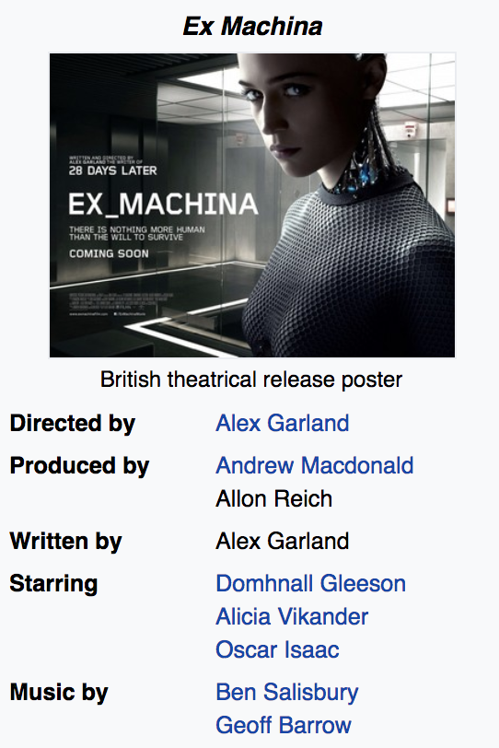

Knowledge base question answering
What else did the director of the movie Ex Machina direct?
Semantic Parsing
select ?y
fb:m.0fkf28
fb:object.type
fb:film.film
fb:m.0fkf28
fb:film.film.directed_by
?y
?x
fb:film.director.film
?y
?y
fb:object.type
fb:film.film
Annihilation 28 Days Later Sunshine
Never let Me Go Dredd
A Scheme For Factoid Question Answering over Knowledge Base
February 25, 2019 3/29
Notes:
So what KB question answering does is to allow user to pose questions in natural language and access answers from the Knowledge base.
For example given some information about Ex Machina, one may ask a question like what else did the director of the movie Ex Machina direct.
So the KB-QA system will try to first understand this question either by semantic parsing methods and convert this question into a structured query which is then executed on the KB to get the answers.
And the advantage of using KB for question answering is that you you can get more precise and accurate answers.

Slide 6
Approach: Task definition
Question:
Where was Barack Obama born?
Fact extraction:
1 – Subject: Barack Obama
1 – Relation: place_of_birth
KB_execution:
USA
The audacity of hope
8/04/1961
bornOn
President _of
Leader
authored_by
home_to
spouse_s
Barack Obama
Hawaii
Place_of_birth
Michelle Obama
has_spouse
origin
Parent
has_spouse
Kenya
Sasha Obama
Answer:
(‘Barack Obama’; ‘place_of_birth’; ‘Hawaii’)
A Scheme For Factoid Question Answering over Knowledge Base
February 25, 2019 3/29
Notes:
So in our work we try to tackle the problem of question answering over KB, specifically simple factoid question answering.
And more formally a simple question is a question of one subject and one relation
Assumption:
Assuming we have a natural language question q as a set of words
And a structured knowledge base with a set of triples where by a triple has two nodes connected by an edge
The task is to come up with a candidate triple from the KB that provides an answer to the question.
We make two assumptions:
We assume that the source entity is mentioned in the question
Question can be answered by a single fact.

Slide 7
Why Simple questions?
Simple questions are common in web search, voice assistants, chatbots etc.
Large Simple questions benchmark with 108, 442 questions.
Simple questions benchmark is far from being solved
(76.4% state-of-the-art)
A Scheme For Factoid Question Answering over Knowledge Base
February 25, 2019 3/29
Notes:
It is also interesting because simples questions are common in web search, voice assistants and chatbots
So in 2015 bodes introduced a simples questions benchmark with over 100,000 questions
And this problem is far from being solved with 76.4% as the state-of-the-art

Slide 8
Related work?
Memory networks (Bodes et al., 2015)
Character-level attention-based Encoder-Decoder (Golub & He, 2016)
Attentive max-pooling (Yin et al., 2016)
Hierarchical word/char-level Encoder ( Lukovinikov et al., 2017)
Standard RNN (Ture and Jojic., 2017)
A Scheme For Factoid Question Answering over Knowledge Base
February 25, 2019 3/29
Notes:
So in 2015, bodes introduced a simple questions dataset and proposed a memory network to tackle this problem
And this dataset triggered a line of work :
Where by some people use hierarchical architecture to enhance the model
Others use attention mechanisms to boost the performance
And others use character level modeling to further improve the performance.
But these new features introduce extra complexity into the models and the question here is whether these complexities are necessary in this particular dataset.

Slide 9
Motivation/Objective
Examine simple and strong baseline that achieve reasonable performance
Examine necessity of model complexity
A Scheme For Factoid Question Answering over Knowledge Base
February 25, 2019 3/29
Notes:
So with this question in mind we took a challenge to:

Slide 10
USA
8/04/1961
The audacity of hope
bornOn
President _of
Leader
authored_by
spouse_s
Barack Obama
Place_of_birth
Hawaii
Michelle Obama
has_spouse
origin
Parent
has_spouse
Kenya
Sasha Obama

Slide 11
Approach: model
1. Entity detection
Where was Barack Obama born?
2. Entity linking
Barack Obama fb:m.07f3jg, fb:m.03hjy39, fb:m.040qyz ...
3. Relation classification
Where was Barack Obama born place of birth, place of death, Date of birth ..
4. End-to-end
(fb:m.07f3jg, place of birth), (fb:m.07f3jg, place of death), (fb:m.03hjy39, place of birth)….
A Scheme For Factoid Question Answering over Knowledge Base
February 25, 2019 3/29
Notes:
So with the aim of examining simple but strong baseline model we decompose the simple question answering problem in 4 components;
The first component is entity detection:
And we basically want to extract the entity from the queries for example;
in this case we want to extract these two tokens (Barack Obama)
The second Component is entity linking because these two tokens
Are not the actual node in the Knowgraph.
In the knowledge graph each entity is represented by a unique ID
So we need to link this text to the knowledge graph.
#And here we keep the top m result because we need to get higher recall and better accuracy.
The third step is relation prediction where we want to get the intention of the query.
For example where was somebody born. This query basically asks about the place of birth
#And similarly here we want to keep the to r relation. #Because because we want to get a better recall.
And we do further choice making in the End-to-end step
In this step we have many combinations and we want to choose the most accurate.

Slide 12
Outline
Introduction
Motivation
Related work
Approach
Results
Conclusion
A Scheme For Factoid Question Answering over Knowledge Base
February 25, 2019 3/29

Slide 13
Introduction

Slide 14
What is a simple question? questions that require extraction of a single fact from knowledge base to be answered
Notes:
Simple questions are a little bit unfamiliar to some people and I wanted to start with a little bit of what they are.

Slide 15
Example
Question
Where was Barack Obama born?
1 - relation
1 - subject
A Scheme For Factoid Question Answering over Knowledge Base
February 25, 2019 3/29
Notes:
More formally a simple question is a question of one subject and one relation

Slide 16
Example
Answer
(‘Barack Obama’; ‘Place of birth’; ’Hawaii’)
A Scheme For Factoid Question Answering over Knowledge Base
February 25, 2019 3/29
Notes:
And answering this kind of question would require the extraction of a tripple or fact if you may from the knowledge base with the object entity as the answer.

Slide 17
Motivation
Notes:
So why is this an interesting subject to study.

Slide 18
Why Simple questions?
Simple questions are common in web search, voice assistants, chatbots etc.
Large Simple questions benchmark with 108, 442 questions.
Simple questions benchmark is far from being solved
(76.4% state-of-the-art)
A Scheme For Factoid Question Answering over Knowledge Base
February 25, 2019 3/29
Notes:
It is also interesting because simples questions are common in web search, voice assistants and chatbots
So in 2015 bodes introduced a simples questions benchmark with over 100,000 questions
And this problem is far from being solved with 76.4% as the state-of-the-art

Slide 19
Related Work

Slide 20
Related work?
Memory networks (Bodes et al., 2015)
Character-level attention-based Encoder-Decoder (Golub & He, 2016)
Attentive max-pooling (Yin et al., 2016)
Hierarchical word/char-level Encoder ( Lukovinikov et al., 2017)
Standard RNN (Ture and Jojic., 2017)
A Scheme For Factoid Question Answering over Knowledge Base
February 25, 2019 3/29
Notes:
So in 2015, bodes introduced a simple questions dataset and proposed a memory network to tackle this problem
And this dataset triggered a line of work :
Where by some people use hierarchical architecture to enhance the model
Others use attention mechanisms to boost the performance
And others use character level modeling to further improve the performance.
But these new features introduce extra complexity into the models and the question here is whether these complexities are necessary in this particular dataset.

Slide 21
Motivation
Examine simple and strong baseline that achieve reasonable performance
Examine necessity of model complexity
A Scheme For Factoid Question Answering over Knowledge Base
February 25, 2019 3/29
Notes:
So with this question in mind we took a challenge to:

Slide 22
Approach

Slide 23
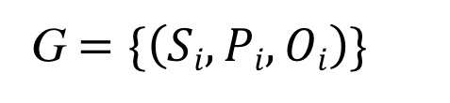
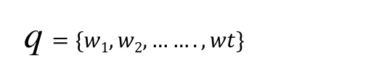
Approach: Task definition
q: question
w: word
Natural language question
q $=\{w1, w2, …….,wt\}$
G: Knowledge base
S: Subject
P: Predicate
O: Object
Structured Knowledge Base
G $=\{\left(Si, Pi, Oi\right)\}$
S
P
O
ˆs : candidate subject
ˆp: candidate predicate
oˆ: candidate object
Task
(ˆs,ˆp, oˆ) ∈ G
A Scheme For Factoid Question Answering over Knowledge Base
February 25, 2019 3/29
Notes:
Assumption:
Assuming we have a natural language question q as a set of words
And a structured knowledge base with a set of triples where by a triple has two nodes connected by an edge
The task is to come up with a candidate triple from the KB that provides an answer to the question.
We make two assumptions:
We assume that the source entity is mentioned in the question
Question can be answered by a single fact.

Slide 24
Approach: model
1. Entity detection
Where was Barack Obama born?
2. Entity linking
Barack Obama fb:m.07f3jg, fb:m.03hjy39, fb:m.040qyz ...
3. Relation classification
Where was Barack Obama born place of birth, place of death, Date of birth ..
4. End-to-end
(fb:m.07f3jg, place of birth), (fb:m.07f3jg, place of death), (fb:m.03hjy39, place of birth)….
A Scheme For Factoid Question Answering over Knowledge Base
February 25, 2019 3/29
Notes:
So with the aim of examining simple but strong baseline model we decompose the simple question answering problem in 4 components;
The first component is entity detection:
And we basically want to extract the entity from the queries for example;
in this case we want to extract these two tokens (Barack Obama)
The second Component is entity linking because these two tokens
Are not the actual node in the Knowgraph.
In the knowledge graph each entity is represented by a unique ID
So we need to link this text to the knowledge graph.
#And here we keep the top m result because we need to get higher recall and better accuracy.
The third step is relation prediction where we want to get the intention of the query.
For example where was somebody born. This query basically asks about the place of birth
#And similarly here we want to keep the to r relation. #Because because we want to get a better recall.
And we do further choice making in the End-to-end step
In this step we have many combinations and we want to choose the most accurate.

Slide 25
Approach: Entity detection
Entity detection
BiLSTM
BiGRU
CRF
A Scheme For Factoid Question Answering over Knowledge Base
February 25, 2019 3/29
Notes:
For Entity detection:
We formulate this as a sequence tagging problem
And do prediction at every time step
We apply both BiLSTM and BiGRU for neural baselines
And we also try CRF as non neural baseline.

Slide 26
Approach: Relation classification
Relation classification
BiLSTM
BiGRU
CNN
A Scheme For Factoid Question Answering over Knowledge Base
February 25, 2019 3/29
Notes:
We also use BiLSTM and BiGRU
But different from entity detection because relation prediction is based on the whole sentence
So we only consider the final hidden state.
We also use CNN which is a typical architecture in text classification task.

Slide 27




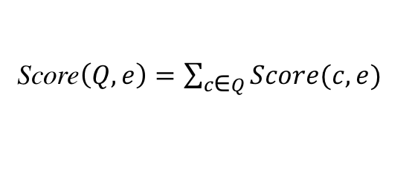
Approach: Details
Score$\left(Q, e\right)=\sum_{c\text{∈} Q}^{ }{Score(c, e)}$
$$\underset{e^{′}}{argmax} \max_{\left(e −r − e^{′}\right)∈\text{I}\text{reach} }Score(Q,e){ }$$
e| r | $e^{′}$
Score$\left(c, e\right)=\max{\text{n}\text{∈}N(c)} BM25(n, e)$
fact
Entity detection
Entity Linking
List(e, Score$\left(Q, e\right))$
Question
Entity: c Relation: r
Filtering
Relation classification
Structured
query
I_{inv}
I_{reach}
Inverted Index
Reachability Index
Knowledge Base
Build Index
Subj| rel | Obj
A Scheme For Factoid Question Answering over Knowledge Base
February 25, 2019 3/29
Notes:
Okay so putting all of this together:
We use the entity detection and relation classification
to convert the question into a structured query and use it to do question answering.
Our structured query is made up of the entity which is a substring of the question
obtained from sequence tagging and relation which is the output of the classifier.
So we build two indexes from the knowledge base to be able to do question answering;
Inverted index maps any n-gram to nodes in the KB with the associated scores
And so we get a list of candidates entity nodes
And use the reachability index to filter out nodes that can’t produce a reasonable answer
And finally we get answer as output.
Reachability Index maps nodes to other nodes (nodes in the freebase subset to all nodes reachable by a single relation)
The above is a quick mapping to be able to do QA in a very efficient way.

Slide 28
Approach: Entity linking – Creating the Inverted Index
e1: max{tfidf(“Barack Obama”, e1), tfid(“Obama”, e1), tfid(“Barack”, e1)}
= tfid(“Barack Obama”, e1)
= Score(n=2, tf=2/3, df=0.001)
e2: score(n=1, tf=1/2, df=0.01)
e3: score(n=1, tf=1, df=0.1)
Entity detection
Question
Entity: “Barack Obama” Relation: bornOn
Entity Linking
Relation classification
Structured
query
I_{inv}
Question
e₁
e₂
Michelle Obama Barack (Person)
Sasha
Obama (Person)
“How old is Barack Obama?”
Barack
e₃
Obama (president)
n-grams
Barack Obama
Obama
A Scheme For Factoid Question Answering over Knowledge Base
February 25, 2019 3/29
Notes:
Okay so here is one example:
We have a question How old is Barack Obama
The structured query then will hopefully have entity Barack Obama
And relation bornOn.
So then for entity linking we will use inverted Index as I mentioned
And the Inverted Index will have mappings from n-grams
Barack
Barack Obama
And Obama
To all the nodes in the KB
And the score of that association will be computed by tfidf
As shown in the equations in the top corner on the right hand side.
So in this case we will have a score for Barack Obama e1
e2 Sasha Obama
And e3 Obama the president

Slide 29
Approach: Entity linking – Creating the Reachability Index
e₄: 0.9
e₆: 0.3
fact
Relation = bornOn
Entity detection
Candidates = [<e₁,0.9>, <e₂,0.3>, <e₃,0.6>]
Question
Entity: “Barack Obama” Relation: bornOn
Entity Linking
Filtering
Relation classification
Structured
query
Question
I_{reach}
e₁
e₂
“How old is Barack Obama?”
presidentOf
Michelle Obama Barack (Person)
Sasha
Obama (Person)
e₅
bornOn
United_states
e₃
e₄
bornOn
Obama (president)
6/10/2001
8/4/1961
e₆
A Scheme For Factoid Question Answering over Knowledge Base
February 25, 2019 3/29
Notes:
The next step is to do filtering now that we have the
candidate nodes from which we believe we can get an answer from.
We want to find the actual answers.
So to do filtering we rely on the structured query again,
We look at the relation type there which is bornOn and we will filter out
all the nodes in our candidate set that do not have an edge born on going
to another node
So in this case e3 will be removed from the list of candidates and then
We will have e1 and e2 each of them being connected to e4 and e6 respectively through the edge bornOn.
So the answer will be e4 and e6 and the score of e4 will be the score of e1, in the previous stage
So e1 got a score of 0.9. so the answer score of e4 will be 0.9 and for e6 0.3.

Slide 30
Results

Slide 31
Experimental set up
Table 1: Simple question dataset Statistics
Table 2: Knowledge base Statistics
A Scheme For Factoid Question Answering over Knowledge Base
February 25, 2019 3/29

Slide 32
Results: Entity detection and linking
Table 3: Entity detection
Table 4: Entity linking
A Scheme For Factoid Question Answering over Knowledge Base
February 25, 2019 3/29

Slide 33
Results: Relation Prediction
Table 5: Relation Prediction
A Scheme For Factoid Question Answering over Knowledge Base
February 25, 2019 3/29

Slide 34
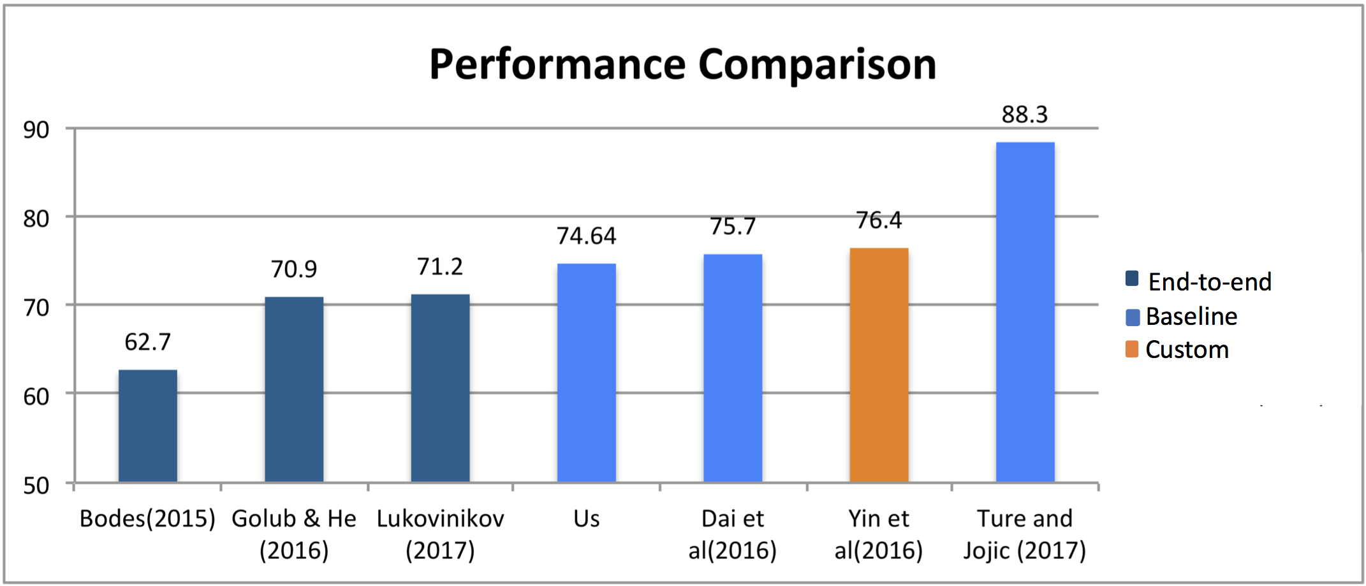
Results: End-to-end Comparison
A Scheme For Factoid Question Answering over Knowledge Base
February 25, 2019 3/29
Notes:
End-to-end are complex features which attempt to do entity and relation prediction in one neural model
The others are baselines
Custom neural architecture with non-standard. architecture

Slide 35
Conclusion

Slide 36
Conclusion
We explore simple yet effective approach for Simple question answering
There is still need to adequately examine simple baselines rigorously before rushing to sophisticated deep learning techniques at least for Simple QA.
Need to consider non-neural network baselines

Slide 37
Thank you Time for human Question Answering! 😉

